Slide 1
Invitation to host
ESICM Lives Forum 2024
²⁰²⁴
^{Vilnius, Lithuania}

Slide 2
Topic and Aim of the LIVES Forum
Organ Perfusion Challenges: Head to Toe
The paramount goal of the Intensive care medicine is an optimal organ perfusion. Therefore we intend to dedicate this ESICM Life Forum to analyze the most state of art diagnostic and clinical approaches dedicated to improve organ perfusion in a different organ systems: cerebral, cardiac, pulmonary, abdominal and peripheral tissues. We are planning one session to focus on research in this field and possible AI input in decision making process.

Slide 3
Proponent Names
Local Co-ordinator: Assoc. Professor Tomas Tamosuitis, MD PhD
Head of Intensive Care Department in Lithuanian University of Health Sciences. Special areas of research and interest:
Multimodality in neurocritical Patient’s management
Cerebral perfusion and autoregulation
Microcirculation and endothelial damage
Organ donation
Organisation and Quality control in Intensive Care and Organ Donation
Prof. Giuseppe Citerio
Professor of Anesthesia and Intensive Care at the Milano Bicocca University, School of Medicine and Surgery.
Director of the Neuroscience Department and Director of Anesthesia and Neurosurgical Intensive Care, at San Gerardo Hospital, ASST-Monza.
He started the Neurointensive and Neuroanesthesia service in the early 1990s at San Gerardo Hospital in Monza, after a previous experience at the San Raffaele Hospital in Milan. While at the Neurosurgical Intensive Care Unit, he has actively participated in national and international research networks, such as BrainIT and CenterTBI. Dr Citerio has also been involved in numerous research protocols and drug trials, many times acting as the principal investigator. His research activities are focused on TBI, subarachnoid hemorrhage, neuroanesthesia, neurointensive care, and brain death/organ donation. He has published more than 400 indexed articles and has an H index of 51. He has participated in the development of international guidelines on the treatment of patients with subarachnoid hemorrhage and neuromonitoring. In addition, he edited the book "Oxford Textbook of Neurocritical Care" (Oxford University Publisher, 2016) with other international colleagues. Dr Citerio is the Editor-in-Chief of INTENSIVE CARE MEDICINE since 2019
Prof. Can Ince
Professor Can Ince, a leader in microcirculation research and technology, works at the Department of Intensive Care, Laboratory of Translational Intensive Care of the Erasmus Medical Center in Rotterdam. Together with his team he conducts both experimental and clinical research directed at cardiovascular aspects of peri-operative medicine. Research topics include clinical microcirculation research in intensive care, cardiothoracic surgery and anesthesiology, blood transfusion, fluid resuscitation, sepsis, shock and resuscitation, acute renal failure, oxygen transport to tissue and mitochondrial function. In addition, the experimental and clinical medical technology research related to the above-mentioned topics is carried out.

Slide 4
Proponent Names
Prof. Fabio Gurracino
Head of the Department of Anesthesia and Critical Care Medicine and Director of Cardiothoracic and vascular Anesthesia and Intensive Care at Azienda Ospedaliero Universitaria in Pisa, Italy.
Editorial Board member of several journals.
Reviewer for several international peer-review journals in the field of intensive care, cardiothoracic anaesthesia, heart failure, echocardiography.
Main research interests are in perioperative echocardiography, acute heart failure and the design of intensive care pathways to improve the effectiveness of the patient journey. President of EACTA 2018-2020.
Dr. Philippe Gaudard, MD PhD
Praticien Hospitalier - Anesthésiste Réanimateur
Chef du Service d’Anesthésie-Réanimation Arnaud de Villeneuve
Pôle Cœur-Poumons
Unité mobile d’assistance circulatoire UMAC 34
PhyMedExp, INSERM U1046, Univ Montpellier
Vice-Président du COGAR
Président de la Sous-Commission des Equipements Médicaux
Membre de la CME, CMDMS, COMAI et DRCI du CHU de Montpellier
Dr. Hatem Soliman-Aboumarie
MBBS MSc MRCP EDICM FHEA FEACVI FASE PGDip MedEd
Consultant in Cardiothoracic Intensive Care
Clinical Lead Organ Donation
Clinical Lead ACCPs Harefield Hospital
Guy's and St Thomas NHS Foundation Trust
Honorary Senior Lecturer
School of Cardiovascular Medicine and Sciences
King’s College London

Slide 5
Proponent Names
Prof. Andrius Pranskunas, MD PhD
Professor and senior researcher in Lithuanian university of health sciences, Lithuania. Intensivist in Hospital of Lithuanian University of Health Sciences, Kaunas, Lithuania. Areas of research are changes in microcirculation, peripheral perfusion and systemic hemodynamics during various interventions in critical ill patients, as well as during experimental conditions. He has extensive experience as an instructor in a variety of international courses since 2002.
Prof. Andrius Macas, MD PhD FESAIC
Head of Anaesthesiology Department in Lithuanian University of Health Sciences. Dean of Medicine. As an educator Andrius Macas leads European Society of Anaesthesiology and Intensive care Education Committee (CEEA) Lithuania‘ Regional Centre is a Board Member of European Board of Anaesthesiology. Lead Expert team of Ministry of Health of Lithuania for undergraduate studies planning in the field of Health Sciences. For 20 years is involved in Study quality assurance. As a clinician works in general anesthesiology, neuroanesthesiology and anesthesiology transplantology, as well as cardiology intensive care. He has been interested in safety anesthesiology and perioperative medicine for many years. Since 2012, the Anesthesiology Department of Kaunas Clinics has been implementing a Safe Medication and Medication Marking System, based on the ISO standard. Since 2018, the Department has started to implement a warning system for the maturity of patients in anesthesiology.
Assoc. Professor Ieva Jovaisiene, MD PhD
Senior researcher and associate professor at Vilnius university, Lithuania. Works as the consultant in cardiac anaesthesia and intensive care in Vilnius University Hospital Santaros Clinics. Lithuania. National representative at European Asociation of Cardiothoracic Anaesthesiology and Intensive Care (EACTAIC). Appointed as an Intensive Care Consultant at Barts Health, London, Uk . Extensive previous experience with international events and research studies. Member of LOC for EACTAIC 2022 conference and Baltanest 2018.
Prof. Tomas Jovaiša, MD PhD
Director of the Center for Anaesthesiology, Intensive Care and Pain Management, Vilnius University Hospital Santaros Klinikos
Areas of special interest:
- Chronic critical illness
- Experimental aspects of respiratory support
- Quality improvement in Intensive care

Slide 6
Experience of the Local Organising Committee
Lithuanian Society of Anaesthesiology and Intensive Care (LSAIC) is an experienced and reliable partner to host ESICM Lives Forum in 2024. We have organised multiple events of similar and larger scale both nationally and internationally.
LSAIC holds four national live educational events each year that attract approximately 300 attendees and our national on-line events attract up to 800 participants.
9th Baltic Congress of Anaesthesiology, Intensive Care and Pain management held in Vilnius, consisted of three to four parallel sessions over three days and attracted more than 1000 participants from the region and further afield. A varied programme was delivered by international faculty with many well-known experts and researches. We enclose the programme of this event along with other supporting information. Considering attendee feedback this was very successful scientific and networking event and was delivered well within a pre-determined budget of 120,000 Eur.
Summary of the delegate feedback. 9th Baltic Congress of Anaesthesiology, Intensive Care and Pain Management (0 – strongly disagree, 5 – strongly agree).

Slide 7
Experience of the Local Organising Committee
Our society in partnership with Go Vilnius and Vilnius University have won the bid to host 37th Annual Congress of the European Society Cardiothoracic Anaesthesiology and Intensive Care in 2022 with a planned audience of 500-600 participants. Local organising committee contributed significantly to both organisational and scientific aspects of the conference. Following Russian aggression in Ukraine and temporary uncertainties regarding safety, this congress was relocated to Naples; however, scientific programme remained largely unchanged with significant contribution from the Lithuanian local organising committee. It is important to note that annual NATO summit is being held in Vilnius this year, serving as major proof that Lithuanian capital city is a safe place for the major international event.
Our society and the members of the local organising committee have well established links with major teaching and research centres in the European Union and beyond, therefore we are certain that this even if held in Vilnius with enjoy an excellent international faculty with broad spectrum of topics and exciting scientific programme. All the members of the proposed steering committee have already expressed their agreement to contribute and take part in this event.
We hope that our bid will be successful and hope to welcome ESICM Lives Forum in Vilnius in 2024.

Slide 8
Destination Support
To support hosting ESICM Lives Forum 2024 Vilnius will provide the following
Tailored site inspection for 1-2 people x 1-2 nights, including European flights
2.000 €*
Material for delegate welcome packs
3.000 €*
Promotional destination marketing collateral
1.000 €*
Cash support for marketing and some costs related to running the conference
10.000 €
TOTAL
16.000 €
*Value of item only and non-transferable to cash
^{January 2023}
^{Vilnius, Lithuania}
All conditions will be outlined and confirmed in a letter of agreement upon notification of the bid win

Slide 9
Before we start, do you know where Vilnius is?
We asked around. Some don’t.

Slide 11
VILNIUS
Modern
Northern
European
Capital
City

Slide 12
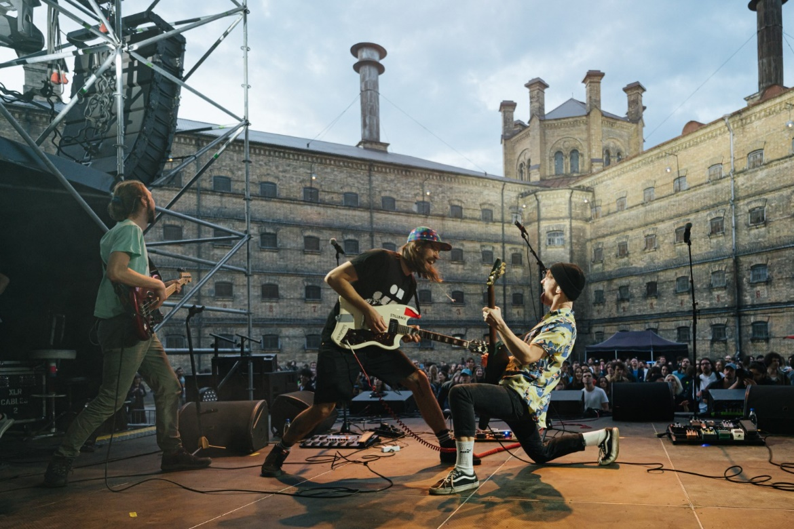
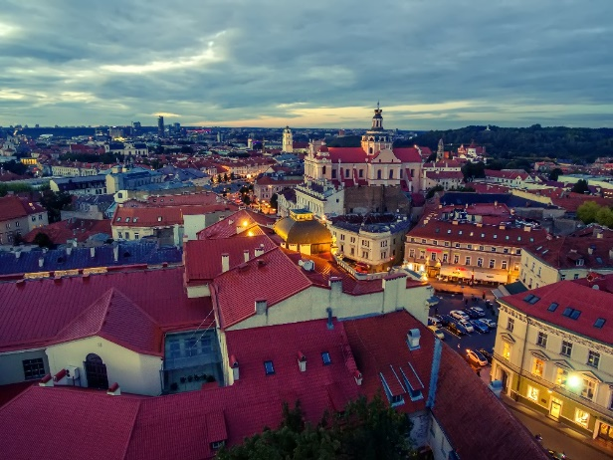
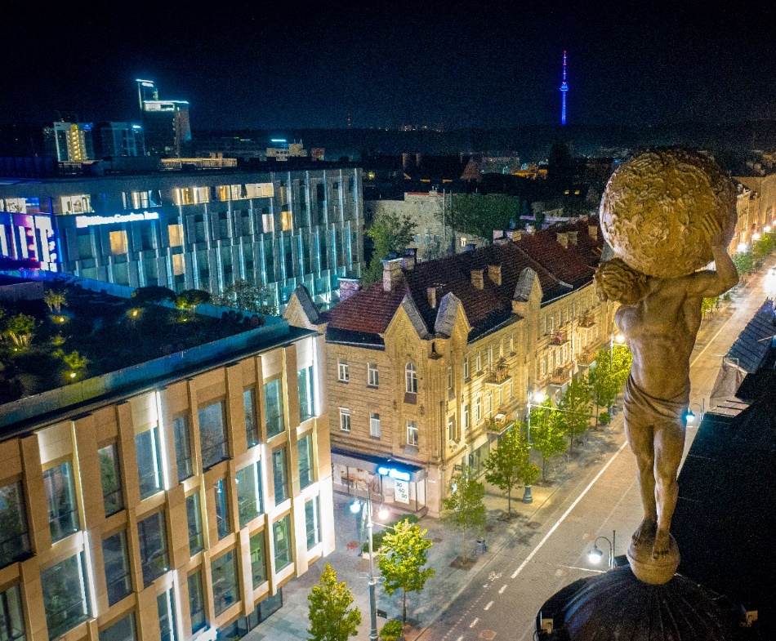
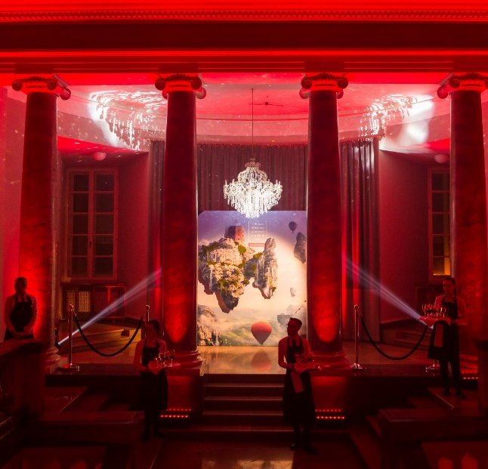
Destination Vilnius
NEXT
BOLD
ARTISTIC
COMFY

Slide 13
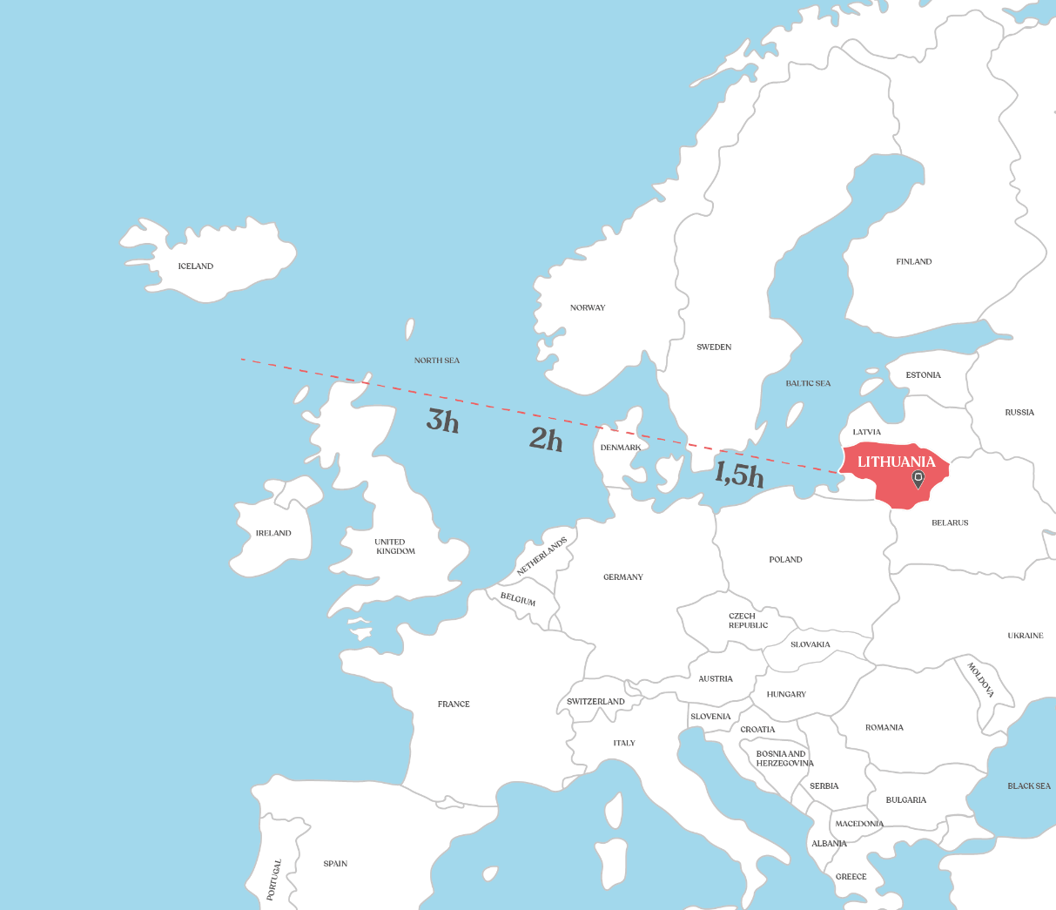
Accessibility
Less than 3 hour
from major European cities
Vilnius airport less than
15 min from city centre
Hotels, venues within walking distance
56
Destinations
29
Countries
11
Airlines

Slide 14
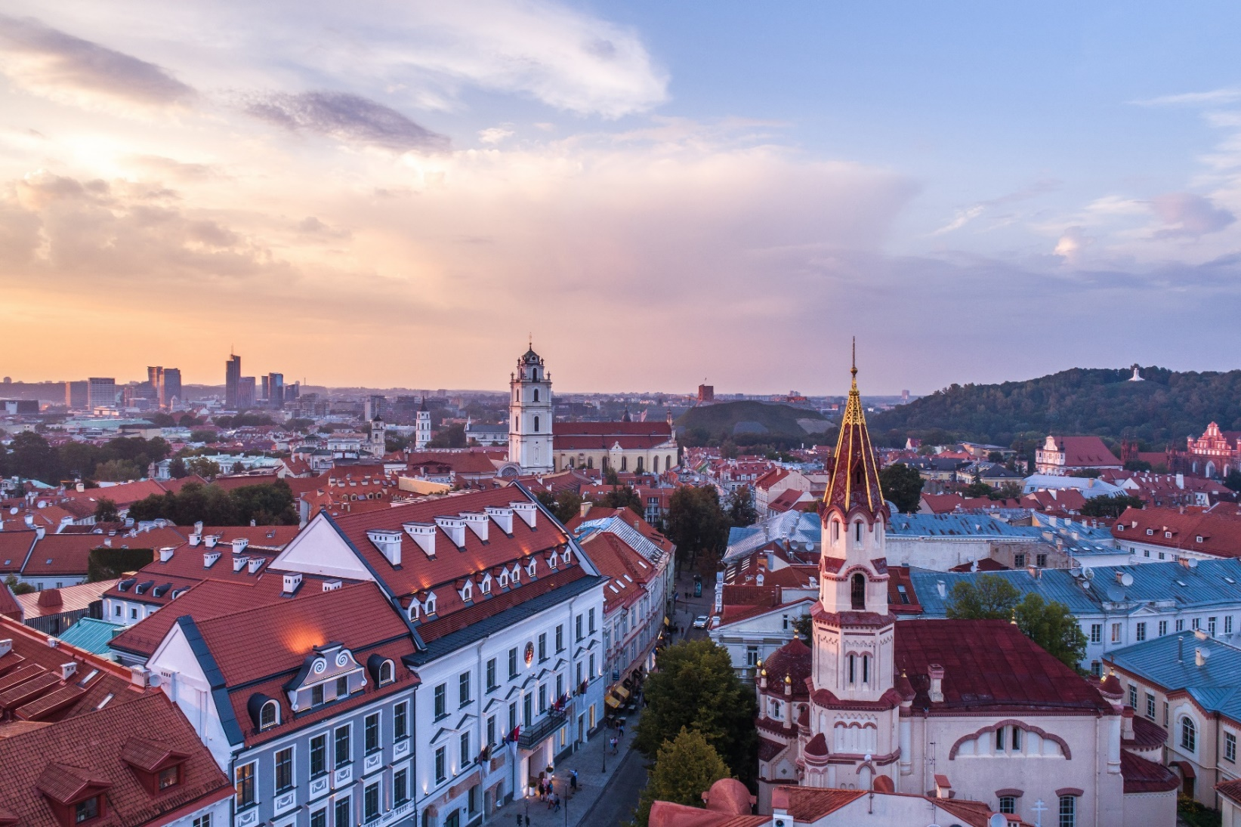
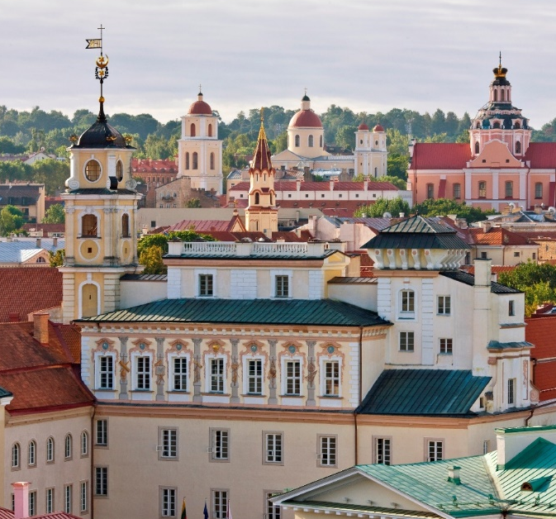
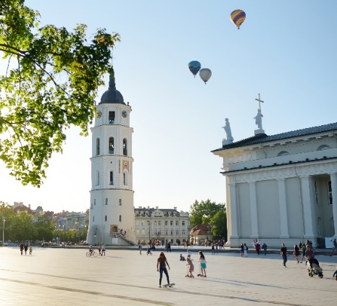
Destination Vilnius
MEDIEVAL Vilnius
Vilnius Old Town with charming examples of the Gothic, Renaissance, Baroque and Classical style is among the largest in Eastern and Central Europe included on the UNESCO World heritage list
^{www.govilnius.lt}

Slide 15
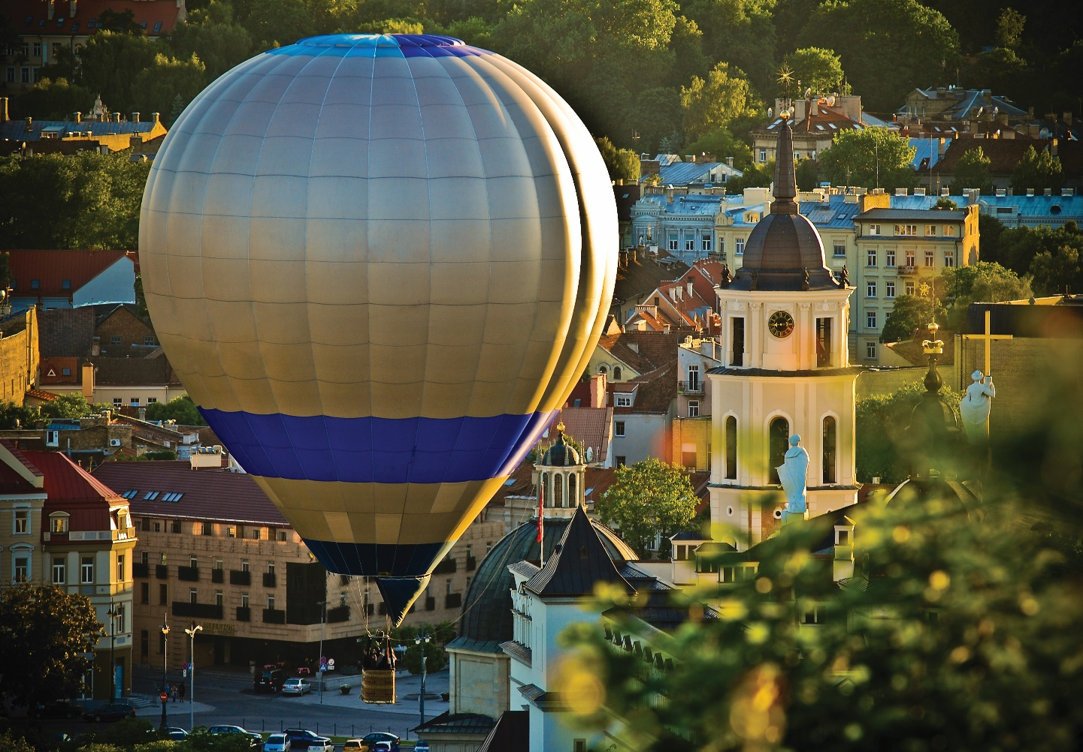
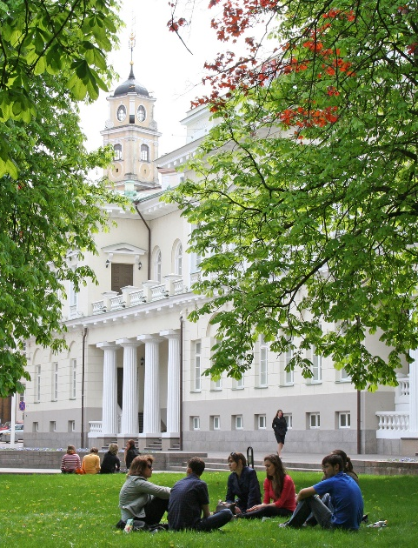
Destination Vilnius
GREEN Vilnius
You’ll find more shades of green than shades of grey because Vilnius feels like it’s part of a huge green forest
46% green space
Nearly half of Vilnius is made up of green space: 3 times more than Amsterdam, Berlin and Warsaw
^{www.govilnius.lt}

Slide 16
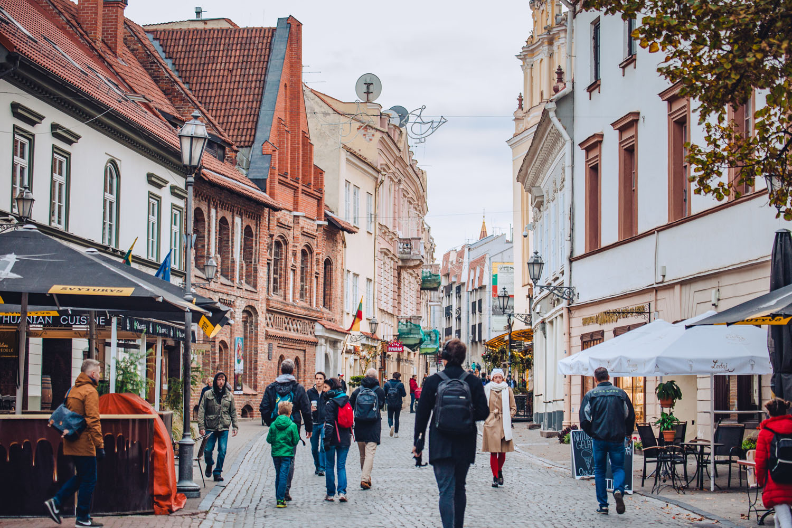
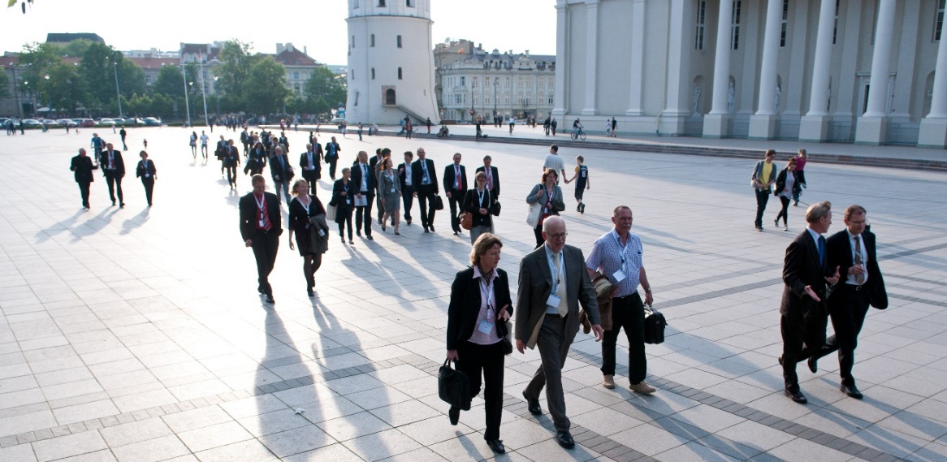
Destination Vilnius
COMPACT Vilnius
Vilnius is a compact, pedestrian-friendly city and getting to the main hotels, venues, restaurants and city sights is just a matter of walking for a few minutes.
Vilnius is among top 5 EU capitals for short commuting (23 min)
^{www.govilnius.lt}

Slide 17
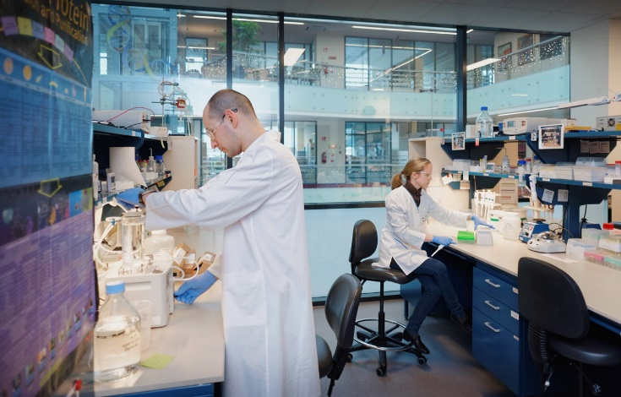
Destination Vilnius
TECH Vilnius
NASA adores us! So do CERN, IBM, Hitachi, Toyota, Mitsubishi…
The Lithuanian made SYLOS laser system is one of the most powerful laser systems in the world.
Lithuania’s laser specialists continue to push the scientific frontier and generate the sector’s impressive growth annually.
^{www.govilnius.lt}

Slide 18
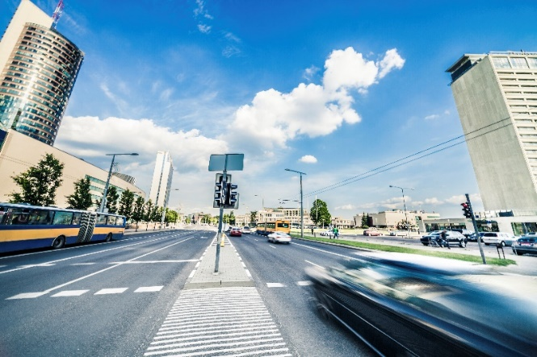
Destination Vilnius
CONNECTED Vilnius
Our internet is legendary. Switch from airplane mode to jet mode. Feel all those megabytes hitting your face while enjoying one of the fastest internet speeds on the planet
^{www.govilnius.lt}

Slide 19
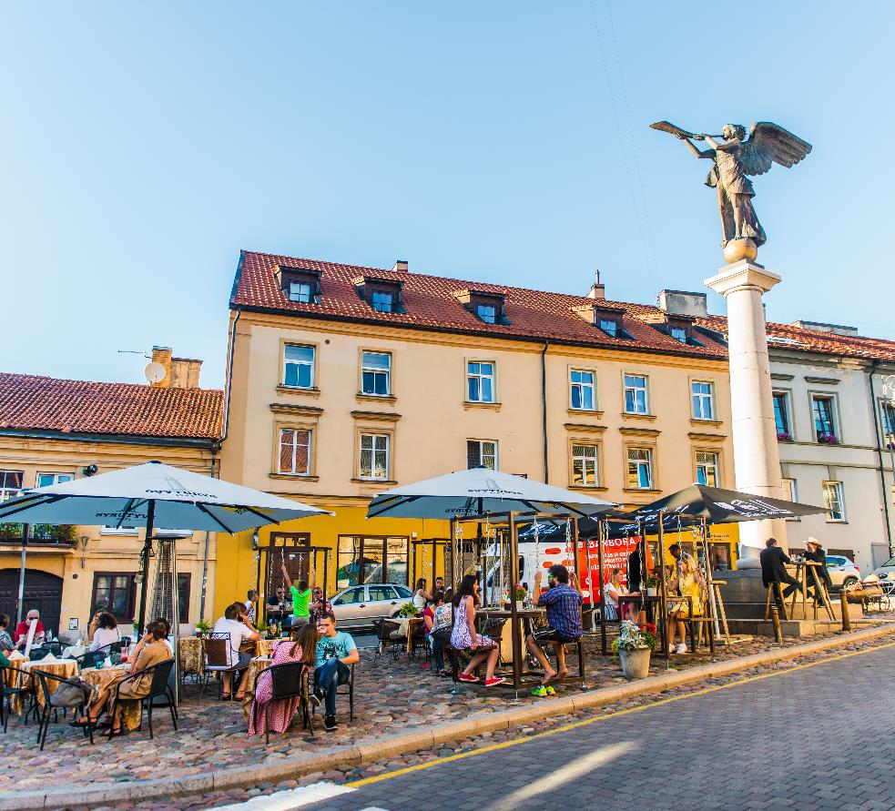
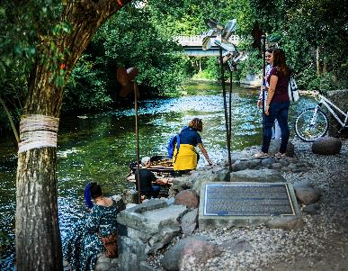
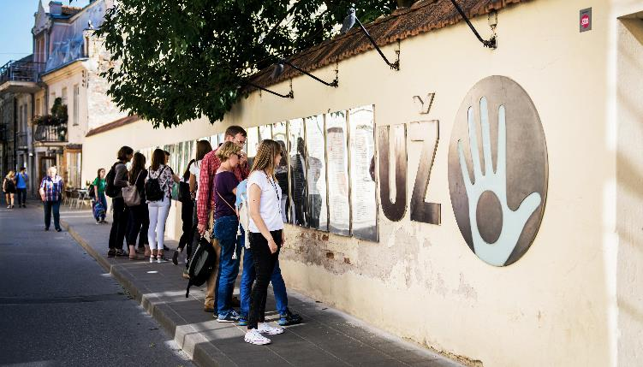
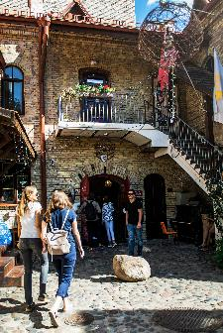
Destination Vilnius
ARTISTIC Vilnius
Now that you’re here, visit another country. Užupis: a Republic inside Vilnius
^{www.govilnius.lt}

Slide 20
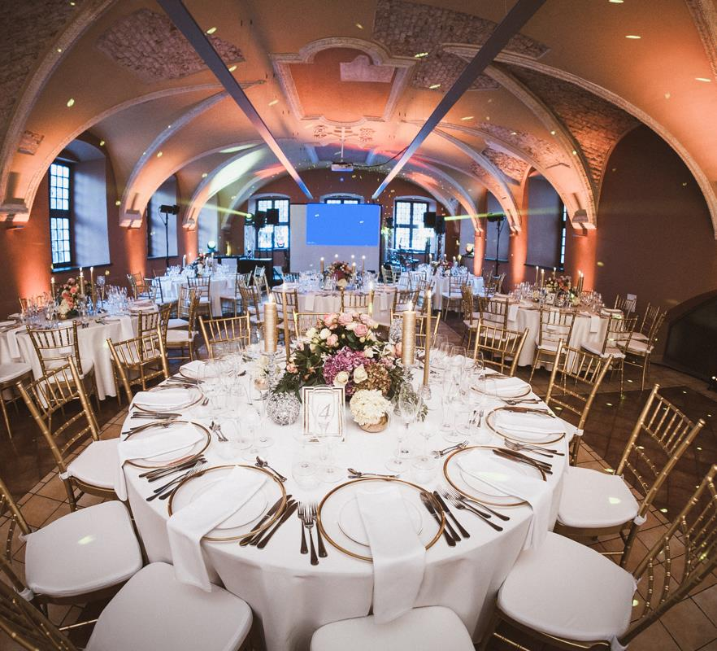
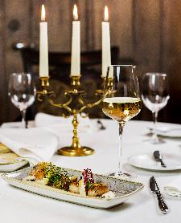
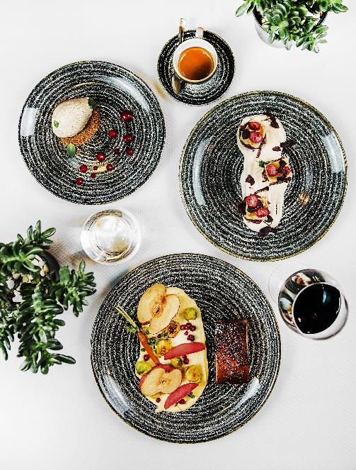
Destination Vilnius
FOODIE Vilnius
Because foodies gonna food. Vilnius’ vibrant food culture will satisfy any plate because every stomach deserves to be happy
^{www.govilnius.lt}

Slide 21
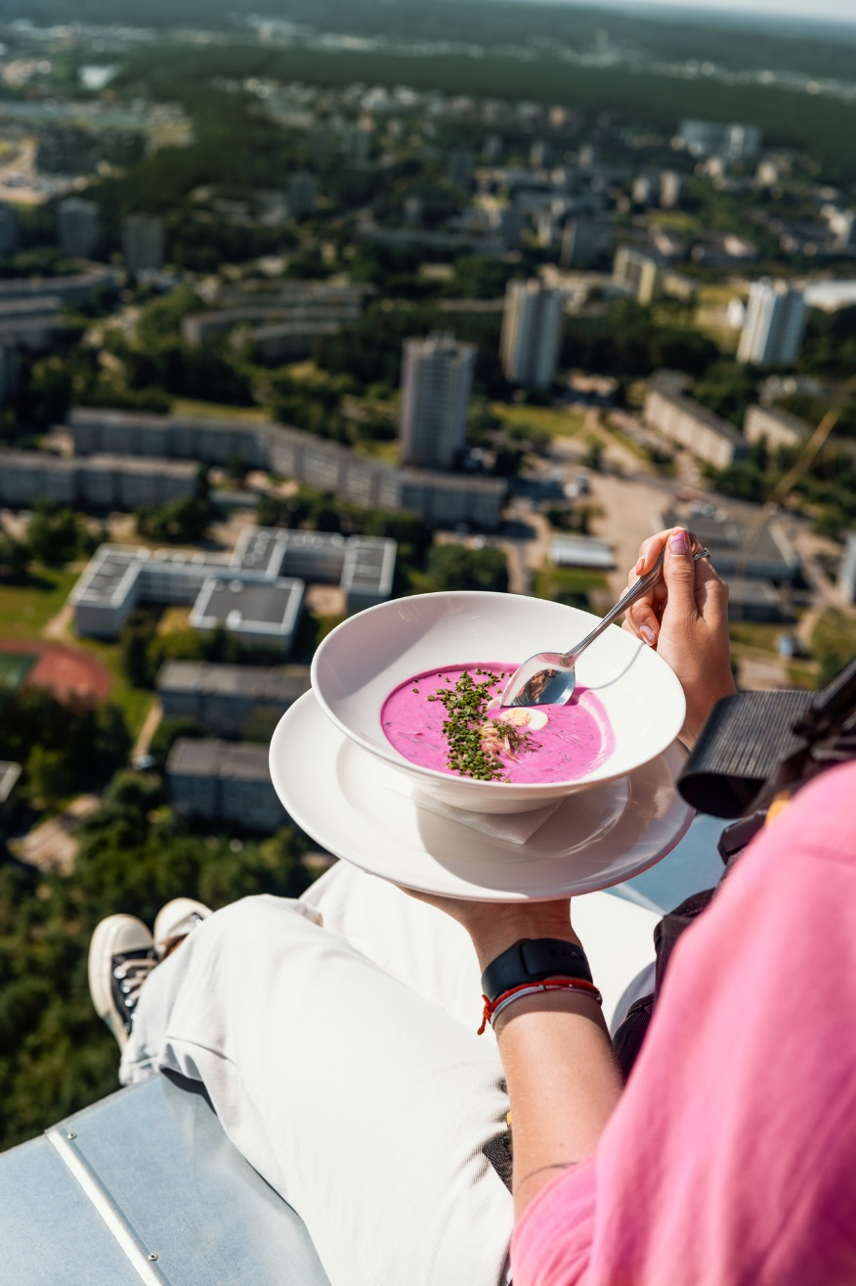
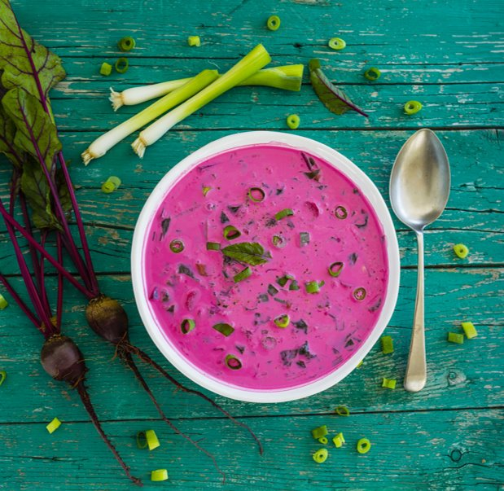
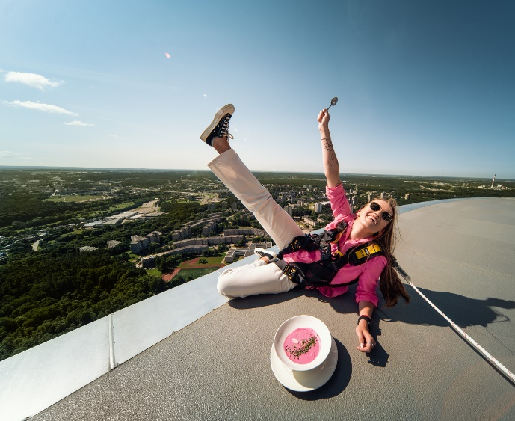
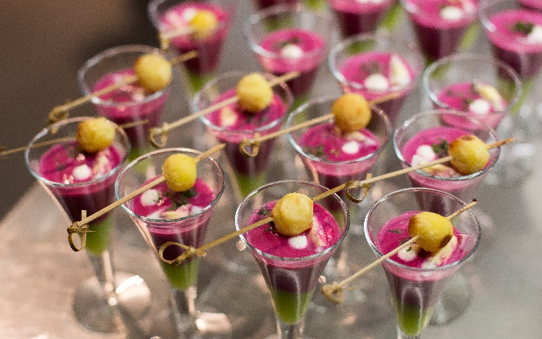
Destination Vilnius
FOODIE Vilnius
Cherished by everyone, our traditional cold beet soup Šaltibarčiai is a time-honoured delight.
Just ask for
[shall-tee-bar-sh-chai]
^{www.govilnius.lt}

Slide 22
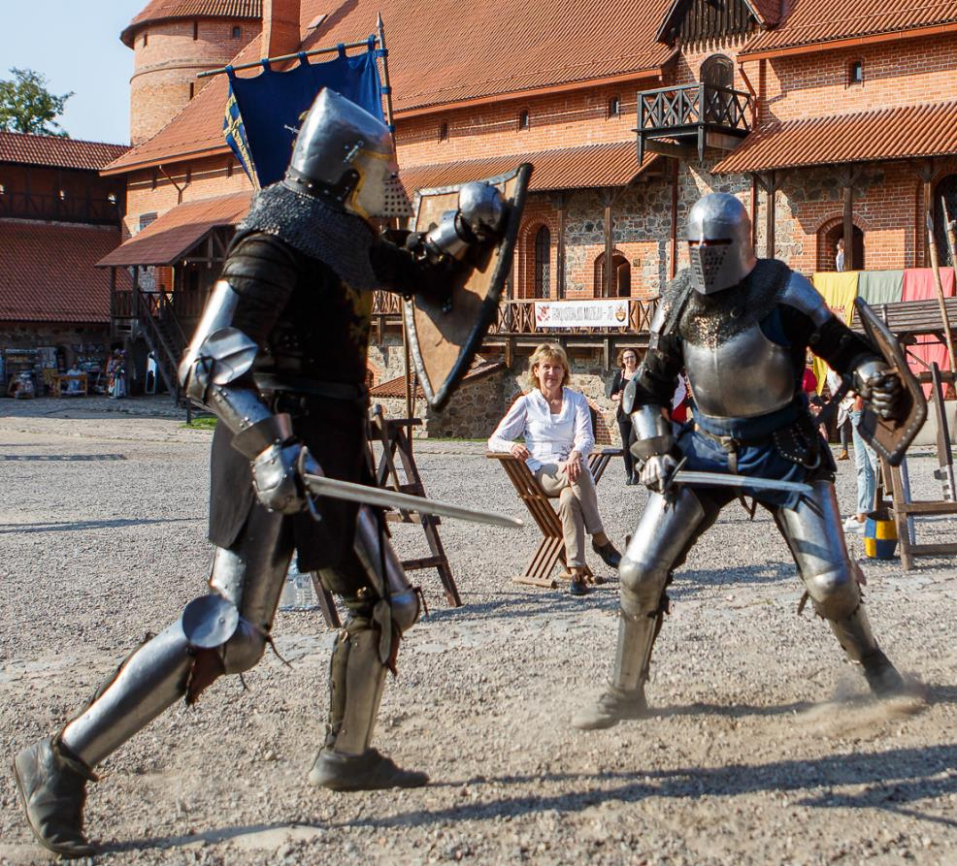
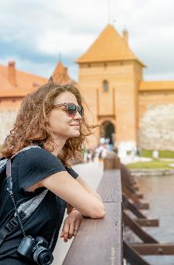
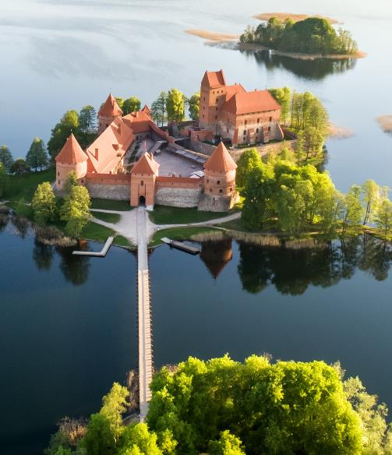
Destination Vilnius
FAIRYTALE Outskirts
Located just 28 km from Vilnius, the Trakai Island Castle is enveloped by legends, poems and an entire lake. It needs to be experienced in person to truly understand and appreciate
^{www.govilnius.lt}

Slide 23
Getting Around
Public Transport
Bus, express bus and trolleybus lines. Timetables at every stop
Shared Mobility
Car, bike, e-scooter sharing system
Taxi
User friendly mobility apps,
1 km – 1 €

Slide 24
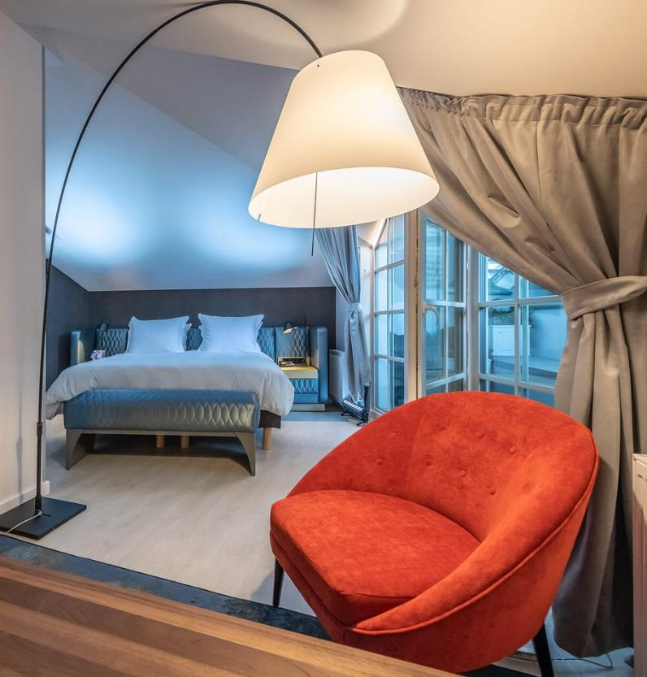
Vilnius Hotels
64
Hotels
5,500+
Current room capacity
120 Eur
Average rate

Slide 25
Meeting Venue

Slide 26
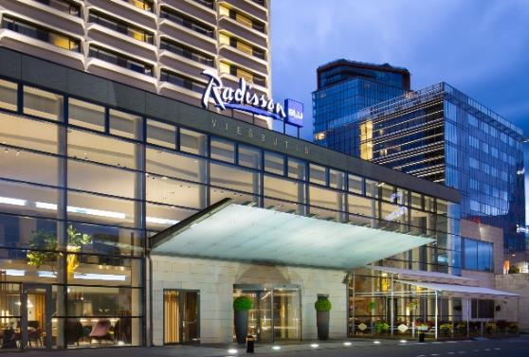
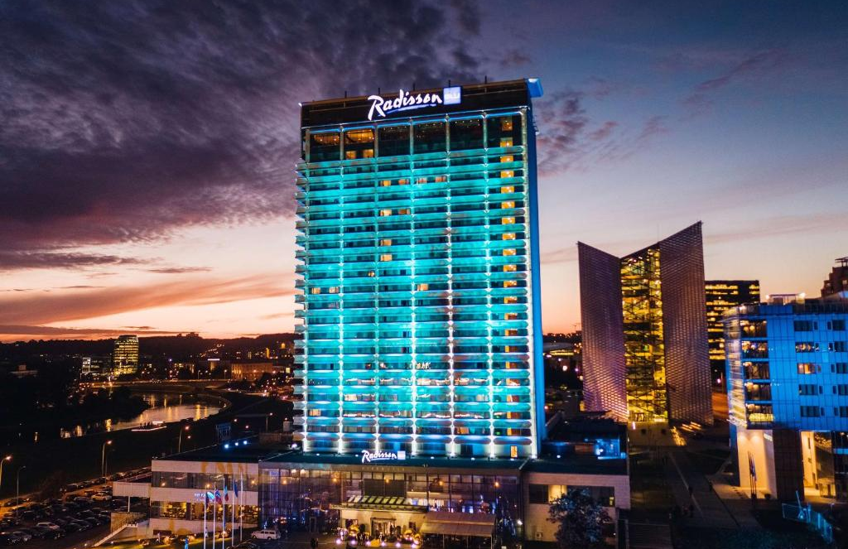
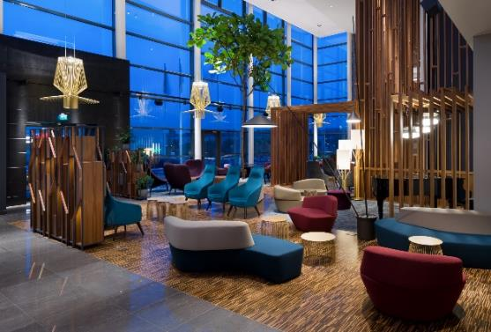
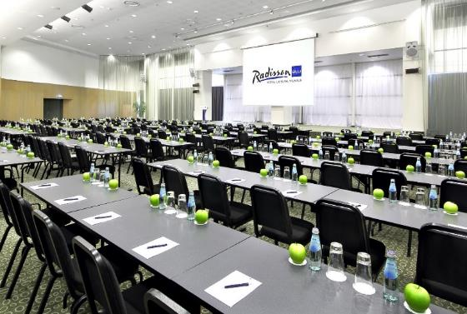
Radisson Blu Hotel Lietuva 4*
Suggested dates:
17-19 May, 2024 24-26 May, 2024 31 May – 2 June, 2024
June 28-30, 2024
^{Meeting}
^{Venue}
4 star, newly reconstructed
Located on the banks of the River Neris in City Center
9 km from Vilnius Airport
1,5 km to Vilnius Old Town
17 meeting halls | 600 pax Theatre Style (Alfa)
Ceiling height up to 6,2 m
Conference Centre Lobby 730 sq. m.
456 rooms
Panoramic Skybar 180 pax
Shopping malls nearby
^{www.radissonhotels.com}

Slide 27
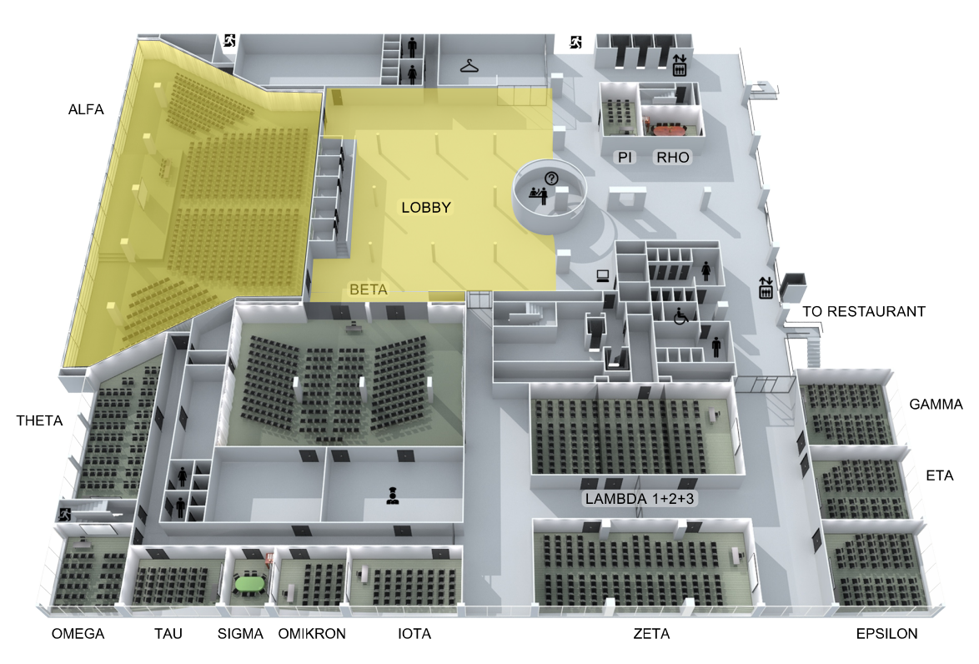
https://
Radisson Blu Hotel Lietuva 4*
Conference Centre Facilities
3D Tour
Plenary
Poster sessions
Detailed information
https://www.govilnius.lt/meet-in-vilnius/venue-finder/hotel-list/radisson-blu-hotel-lietuva
Breakout
Breakout
Breakout
^{www.radissonhotels.com}

Slide 28
Social Programme Venues

Slide 29
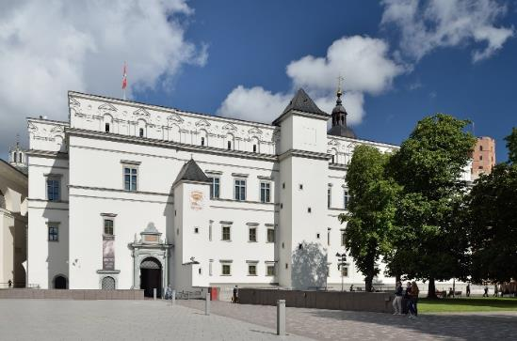
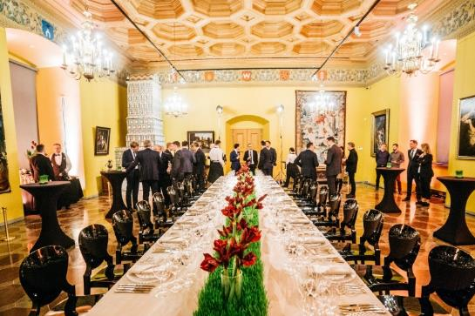
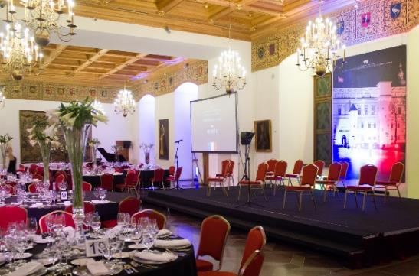
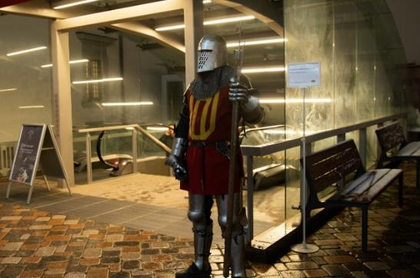
The Palace of the Grand Dukes of Lithuania
Option 1
Dinner Venue
^{Gala}
^{Dinner}
3D Tour
In the heart of Vilnius Old Town – Cathedral Square
350 pax. Reception | 250 pax. Seated Dinner
1,5 km from the Radisson Blu Hotel Lietuva
Modern museum built on the oldest ruins
Gala dinner combined with special guided tours of the palace’s underground museum
^{www.valdovurumai.lt}

Slide 30
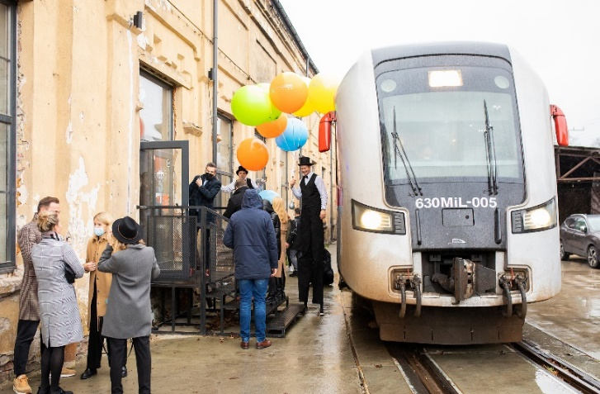
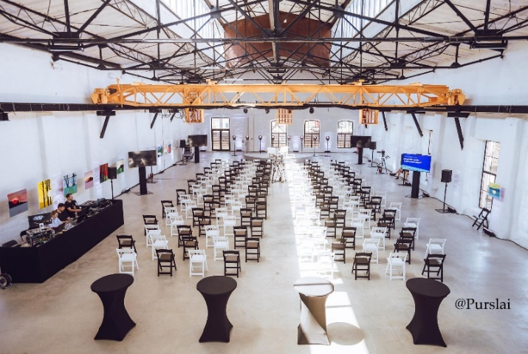
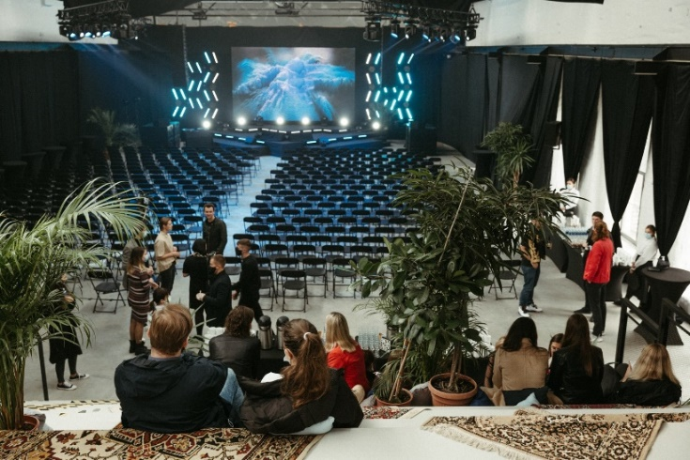
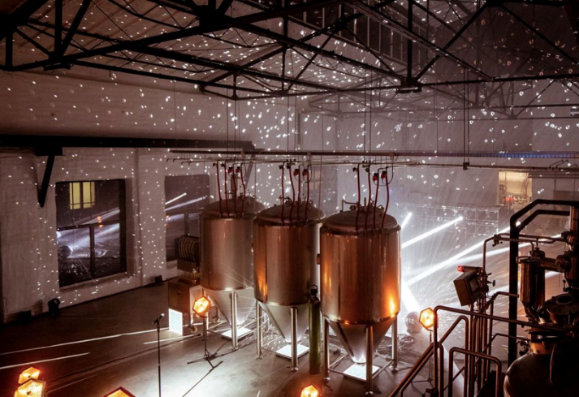
Smoke Factory
Option 2
Dinner Venue
^{Gala}
^{Dinner}
3D Tour
Historic 19th cent building
750 m² space for events
With modern craft brewery operating on the premises
A unique possibility to travel to the place by privately rent train from the main Railway Station - stops right to the venue entrance (railway tracks next to the building)
13 km from the Radisson Blu Hotel Lietuva
^{www.dumufabrikas.lt}

Slide 31
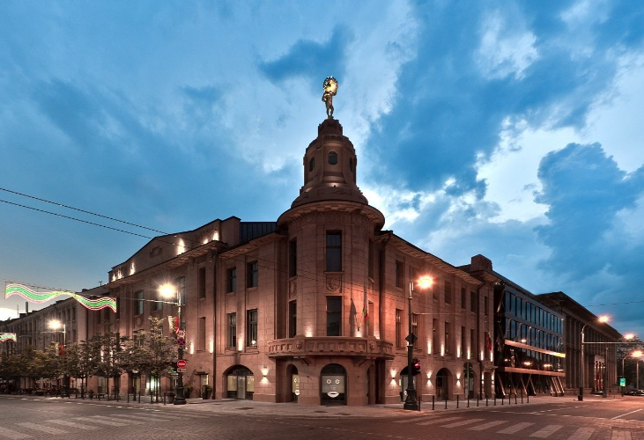
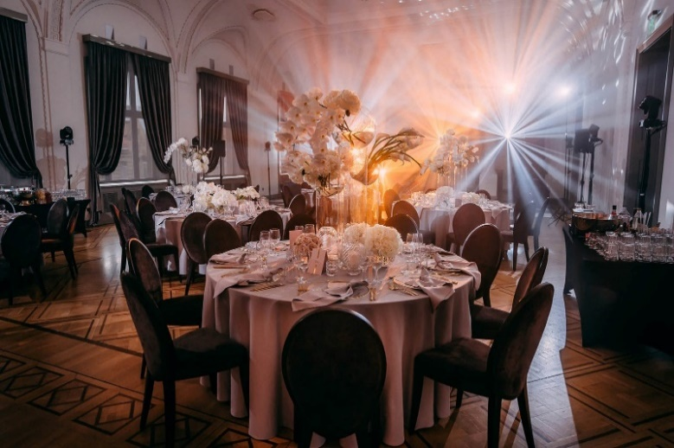
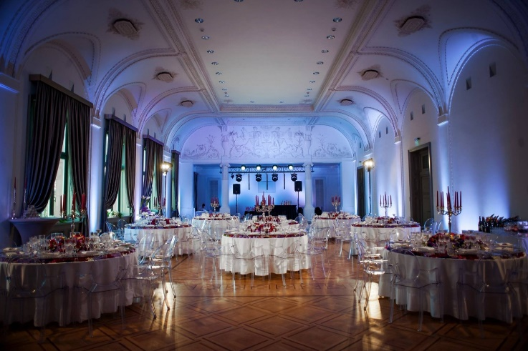
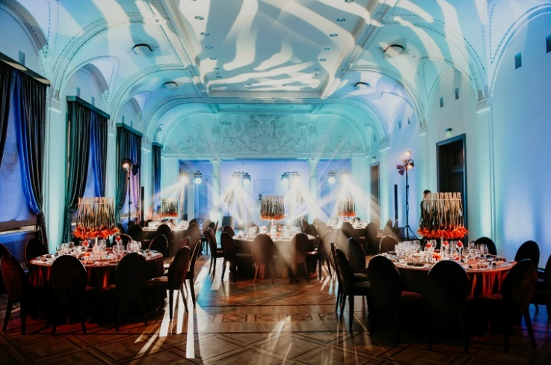
Merchants’ Club
Option 4
Dinner Venue
^{Gala}
^{Dinner}
3D Tour
Two event halls with preserved historical value of the authentic Merchnats’ Club
Located in the City Centre
250 pax. Reception | 160 pax. Seated Dinner
1,5 km from the Radisson Blu Hotel Lietuva
^{www.pirkliuklubas.lt}

Slide 32
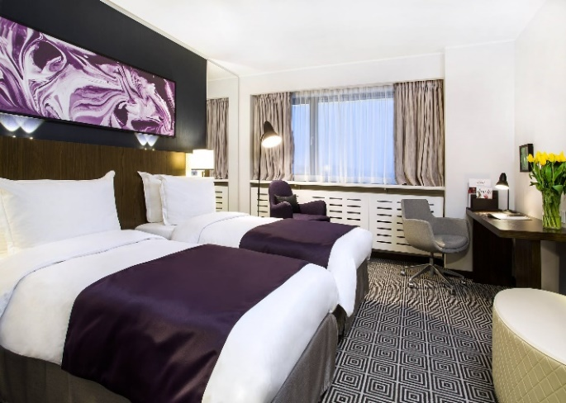
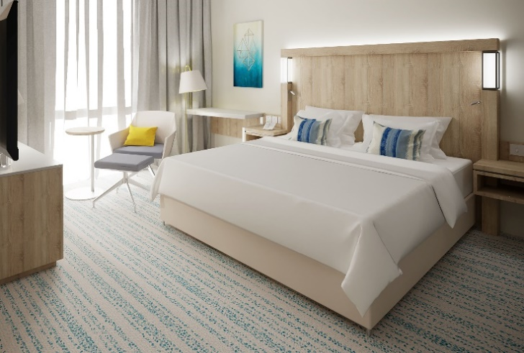
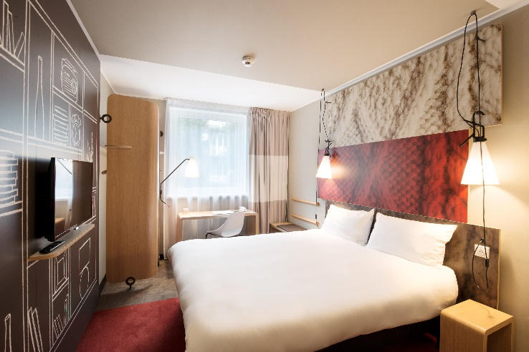
Accommodation Options
Radisson Blu Hotel Lietuva 4*
Rooms: 456
www.radissonhotels.com
Room rate: 130 Eur
Courtyard Vilnius City Center 4*
Rooms: 199
Distance from Radisson: 1,1 km www.courtyardvilnius.com
Room rate: 100 Eur
ibis Vilnius Centre 3*
Rooms: 162
Distance from Radisson: 900 m
www.accorhotels.com
Room rate: 60 Eur
The Radisson Blu Hotel Lietuva 4* - suggested HQ Hotel, can be easily combined with other hotels located in a walking distance
Dormitory options for students for 15-50 Eur per room.
Indicated prices are preliminary ones. Vilnius City Tax 1 Eur per person/per night is NOT included in room rates

